Slide 1
Defining the Problem Domain
[...Bjørn H. Westh] TID 13-09-2022, ITU CPH

Slide 2
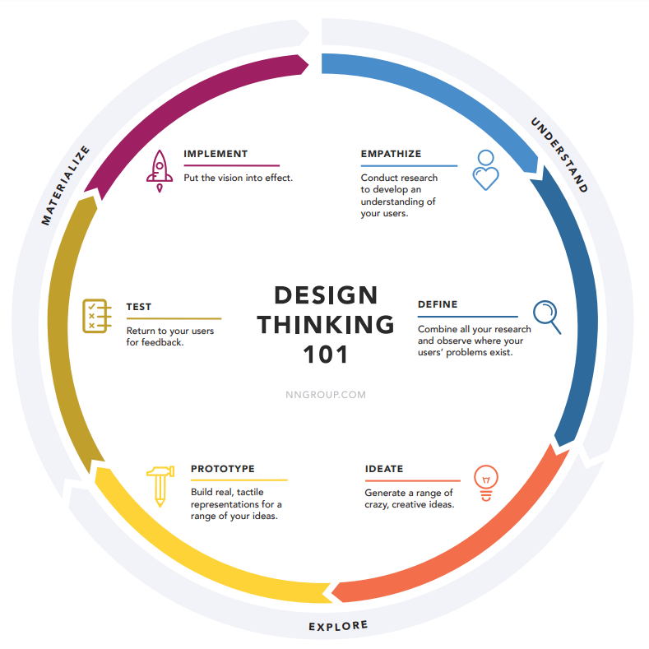
defining problem domain
https://media.nngroup.com/media/articles/attachments/Design-thinking-101-NNG.pdf
[...Bjørn H. Westh] TID 13-09-2022, ITU CPH

Slide 3
defining problem domain
https://media.nngroup.com/media/articles/attachments/Design-thinking-101-NNG.pdf
[...Bjørn H. Westh] TID 13-09-2022, ITU CPH

Slide 4
defining problem domain
https://media.nngroup.com/media/articles/attachments/Design-thinking-101-NNG.pdf
[...Bjørn H. Westh] TID 13-09-2022, ITU CPH

Slide 5
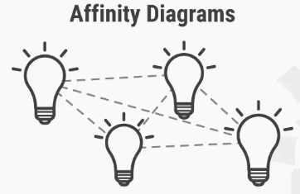
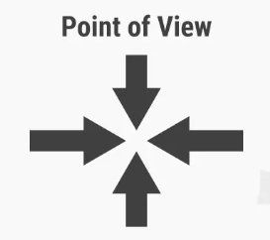
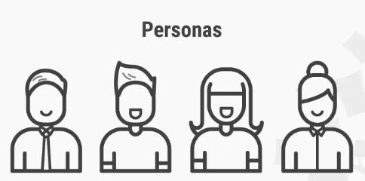
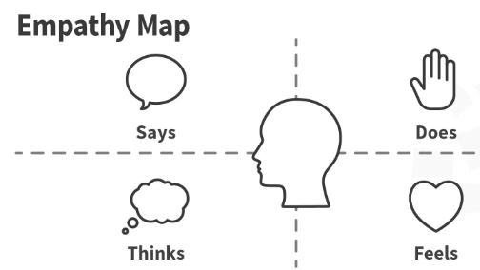
defining problem domain
(Problem Statement)
[...Bjørn H. Westh] TID 13-09-2022, ITU CPH

Slide 6
defining problem domain
(Problem Statement)
[...Bjørn H. Westh] TID 13-09-2022, ITU CPH

Slide 7
defining problem domain
(Problem Statement)
[...Bjørn H. Westh] TID 13-09-2022, ITU CPH

Slide 8
The Personas
[...Bjørn H. Westh] TID 13-09-2022, ITU CPH

Slide 9
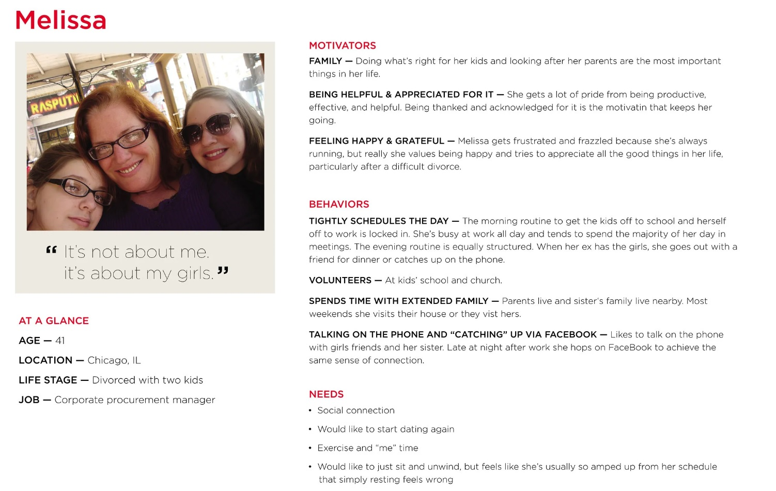
defining problem domain/personas
[...Bjørn H. Westh] TID 13-09-2022, ITU CPH

Slide 10
defining problem domain/personas
[...Bjørn H. Westh] TID 13-09-2022, ITU CPH

Slide 11
defining problem domain/personas
1. Goal-Directed Personas
[...Bjørn H. Westh] TID 13-09-2022, ITU CPH

Slide 12
defining problem domain/personas
1. Goal-Directed Personas
2. Role-Based Personas
[...Bjørn H. Westh] TID 13-09-2022, ITU CPH

Slide 13
defining problem domain/personas
1. Goal-Directed Personas
2. Role-Based Personas
3. Engaging Personas
[...Bjørn H. Westh] TID 13-09-2022, ITU CPH

Slide 14
defining problem domain/personas
1. Goal-Directed Personas
2. Role-Based Personas
3. Engaging Personas
4. Proto Personas
[...Bjørn H. Westh] TID 13-09-2022, ITU CPH

Slide 15
defining problem domain/personas
Engaging Personas
1. Collect data
2. Form a hypothesis
4. Establish a number of personas
5. Construct personas
6. Prepare situations for your personas
9. Create scenarios for your personas
[...Bjørn H. Westh] TID 13-09-2022, ITU CPH

Slide 16
The POV Problem Statement
[...Bjørn H. Westh] TID 13-09-2022, ITU CPH

Slide 17
defining problem domain/problem Statement
Problem Statement
[...Bjørn H. Westh] TID 13-09-2022, ITU CPH

Slide 18
defining problem domain/problem Statement
Problem Statement
Define Your User
[...Bjørn H. Westh] TID 13-09-2022, ITU CPH

Slide 19
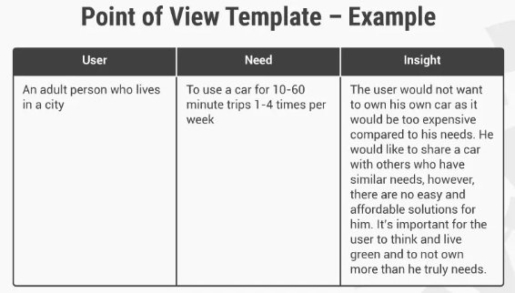
defining problem domain/problem Statement
Problem Statement
Define Your User
Express Your Definitions
[...Bjørn H. Westh] TID 13-09-2022, ITU CPH

Slide 20
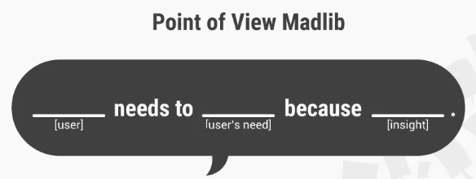
defining problem domain/problem Statement
Problem Statement
Define Your User
Express Your Definitions
Create Your POV Madlib
[...Bjørn H. Westh] TID 13-09-2022, ITU CPH

Slide 21
defining problem domain/problem Statement
Problem Statement
Define Your User
Express Your Definitions
Create Your POV Madlib
Make Sure Your POV is on Point
Does it:
Provide a narrow focus?
Frame the design challenge as a POV?
Inspire your team to help your users?
Guide your innovation efforts and ideation process?
Inform criteria to evaluate competing ideas?
Capture people’s attention?
Seem valid, insightful, actionable, unique, meaningful and exciting?
[...Bjørn H. Westh] TID 13-09-2022, ITU CPH

Slide 22
defining problem domain/problem Statement
Problem Statement
“Design a poster which increases sign-ups to interviews for our research project.”
VS
“Why are people not signing up to participate in our research project?”
[...Bjørn H. Westh] TID 13-09-2022, ITU CPH

Slide 23
defining problem domain/problem Statement
Problem Statement
“Redesign the packaging so our product is more noticeable on the shelf.”
VS
“What is it about our product that causes people to ignore it?”
[...Bjørn H. Westh] TID 13-09-2022, ITU CPH

Slide 24
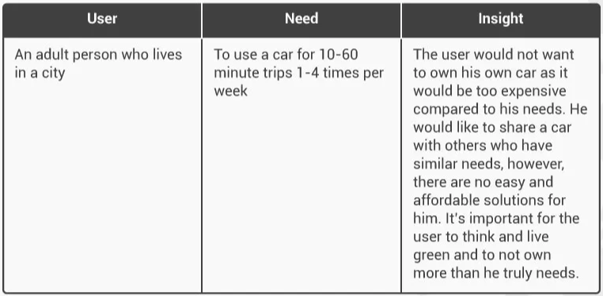
defining problem domain/problem Statement
[User . . . (description)] needs [Need . . . (verb)] because [Insight . . . (compelling statement)]Problem Statement
[...Bjørn H. Westh] TID 13-09-2022, ITU CPH

Slide 25
defining problem domain/problem Statement
“An adult person who lives in a city needs to use a car for 10-60 minute trips per week because the user does not want to own their own car as it would be too expensive, as well as too taxing on the environment.”
[...Bjørn H. Westh] TID 13-09-2022, ITU CPH

Slide 26
The “How Might We” Question
[...Bjørn H. Westh] TID 13-09-2022, ITU CPH

Slide 27
defining problem domain/how might we
The “How Might We” Question
[...Bjørn H. Westh] TID 13-09-2022, ITU CPH

Slide 28
defining problem domain
https://media.nngroup.com/media/articles/attachments/Design-thinking-101-NNG.pdf
[...Bjørn H. Westh] TID 13-09-2022, ITU CPH

Slide 29
defining problem domain
https://media.nngroup.com/media/articles/attachments/Design-thinking-101-NNG.pdf
[...Bjørn H. Westh] TID 13-09-2022, ITU CPH

Slide 30
defining problem domain/how might we
The “How Might We” Question
“An adult person who lives in a city needs to use a car for 10-60 minute trips per week because the user does not want to own their own car as it would be too expensive, as well as too taxing on the environment.”
[...Bjørn H. Westh] TID 13-09-2022, ITU CPH

Slide 31
defining problem domain/how might we
The “How Might We” Question
“An adult person who lives in a city needs to use a car for 10-60 minute trips per week because the user does not want to own their own car as it would be too expensive, as well as too taxing on the environment.”
“How might we give a person access to a shared car when they need it?”
[...Bjørn H. Westh] TID 13-09-2022, ITU CPH

Slide 32
defining problem domain/how might we
The “How Might We” Question
“An adult person who lives in a city needs to use a car for 10-60 minute trips per week because the user does not want to own their own car as it would be too expensive, as well as too taxing on the environment.”
“How might we give a person access to a shared car when they need it?”
“How might we help people feel more comfortable living without a car?”
[...Bjørn H. Westh] TID 13-09-2022, ITU CPH

Slide 33
defining problem domain/how might we
The “How Might We” Question
“An adult person who lives in a city needs to use a car for 10-60 minute trips per week because the user does not want to own their own car as it would be too expensive, as well as too taxing on the environment.”
“How might we give a person access to a shared car when they need it?”
“How might we help people feel more comfortable living without a car?”
“How might we provide alternative forms of transportation when a car isn’t strictly necessary?”
[...Bjørn H. Westh] TID 13-09-2022, ITU CPH

Slide 34
FIN
[...Bjørn H. Westh] TID 13-09-2022, ITU CPH

